Slide 1

Computing Algorithms Lecture 11: Space and Time Trade-off
By: Dr. Mohamed Moheeb

Slide 2
Agenda
Introduction
Count Sorting
Horspool’s algorithm
Hashing

Slide 3

Introduction

Slide 4
Introduction
Most algorithms can be optimized in one of two directions: Time (how long it takes to finish) or Space (how much RAM or disk space it uses). Improving one usually makes the other worse
You can speed up an algorithm by storing "pre-calculated" results in memory, so the computer doesn't have to calculate them again later (e.g., using a lookup table or a cache).
You can save memory by calculating data on-the-fly only when it is needed. This keeps your memory footprint small but requires the CPU to work harder and take more time every time that data is accessed.

Slide 5
Count Sorting

Slide 6
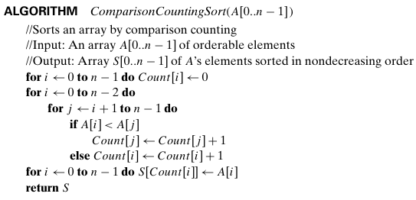
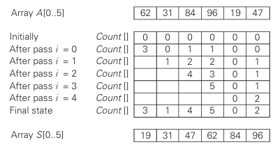
Count Sorting

Slide 7
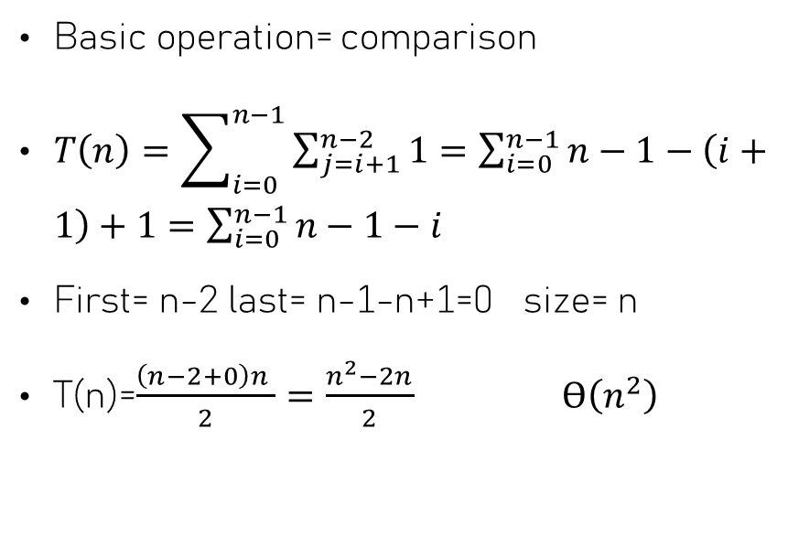
Count Sorting
Basic operation= comparison
$T\left(n\right)=\sum_{i=0}^{n−1}{\sum_{j=i+1}^{n−2}{1}}=\sum_{i=0}^{n−1}{n−1−\left(i+1\right)+1}=$ $\sum_{i=0}^{n−1}{n−1−i}$
First= n-2 last= n-1-n+1=0 size= n
T(n)=$\frac{\left(n−2+0\right)n }{2}=\frac{n^{2}−2n}{2} ϴ\left(n^{2}\right)$

Slide 8
Horspool’s Algorithm

Slide 9
Horspool’s algorithm
Before looking at the text, the algorithm analyzes the pattern and creates a shift table. This table tells the algorithm exactly how many positions to jump ahead based on the character in the text that aligns with the last character of your pattern
The algorithm aligns the pattern with the start of the text but, crucially, it compares characters from right to left
When a mismatch occurs (or even after a match is found), the algorithm doesn't just move one step. It looks at the character in the text that was aligned with the pattern's tail, checks your shift table, and "slides" the pattern forward by that amount.

Slide 10
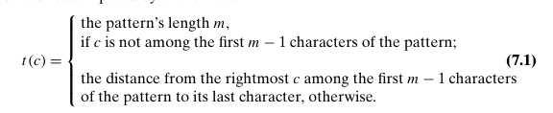
Horspool’s algorithm
The rule for constructing the shifting table

Slide 11
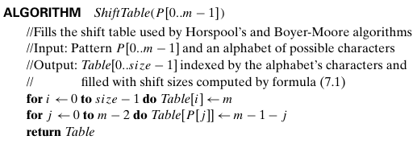

Horspool’s algorithm
Consider, as an example, searching for the pattern BARBER in some text

Slide 12
Horspool’s algorithm
Horspool’s algorithm
Step 1 For a given pattern of length m and the alphabet used in both the pattern and text, construct the shift table as described above.
Step 2 Align the pattern against the beginning of the text.
Step 3 Repeat the following until either a matching substring is found or the pattern reaches beyond the last character of the text.
Starting with the last character in the pattern, compare the corresponding characters in the pattern and text until either all m characters are matched (then stop) or a mismatching pair is encountered.
In the latter case, retrieve the entry t(c)from the c’s column of the shift table where c is the text’s character currently aligned against the last character of the pattern, and shift the pattern by t(c) characters to the right along the text.

Slide 13

Horspool’s algorithm

Slide 14
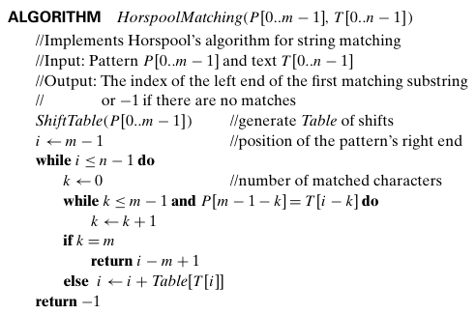
Horspool’s algorithm
The best case is same as brute force is ϴ(n)
The worst case is O(n.m)
Why ?
Please solve this problem the pattern is ‘baaaa’ and text is ‘aaaaaaaaaaaaaaaaaa’

Slide 15
Hashing

Slide 16
Hashing
The Problem: Direct addressing is impossible when the universe of keys is significantly larger than the available memory slots.
A technique that maps a large set of keys into a smaller, fixed-size array called a Hash Table.
Objective: To achieve constant time O(1) for Search, Insert, and Delete operations on average.

Slide 17
Hash function
Definition: A mathematical function h(K) that transforms a key K into an integer index i within the range [0, m-1].
The Mapping: h: K to {0, 1, ……, m-1\}.
Since |K| > m, two different keys K1 and K2 will eventually map to the same index. This is known as a Collision, which the system must resolve.

Slide 18
Designing a "Good" Hash Function
Determinism: The same input must always produce the same hash value.
Efficiency: The function must be O(1) and computationally inexpensive.
Uniformity: It should distribute keys evenly across all slots to minimize clustering and collisions.
Common Techniques:
Division Method: h(K) = K mod m (Best when m is a prime number not close to a power of 2).

Slide 19
Open Hashing (Separate Chaining)
The hash table is an array of pointers. Each slot (bucket) points to a linked list of all records that hash to that same index
Advantages:
The table never truly "fills up" (limited only by system memory).
Simple to implement and handles deletions gracefully.
Disadvantage:
Extra memory overhead for pointers and potential O(n) performance if one list becomes too long.

Slide 20
Open Hashing example
Each list contains all the keys hashed to its cell. Consider, as an example, the following list of words: A, FOOL, AND, HIS, MONEY, ARE, SOON, PARTED.
Hash function we will add the positions of a word’s letters in the alphabet and compute the sum’s remainder after division by 13
Example:
FOOL—is installed in the ninth cell since (6 + 15+15+12)mod13=9

Slide 21
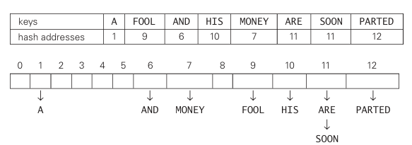
Open hashing

Slide 22
Closed Hashing
All elements are stored within the hash table itself. No links or pointers are used outside the array.
If h(K) is occupied, the algorithm systematically probes for the next available "open" slot.
Strategies:
Linear Probing: Checking slots sequentially (i+1, i+2 ………).

Slide 23
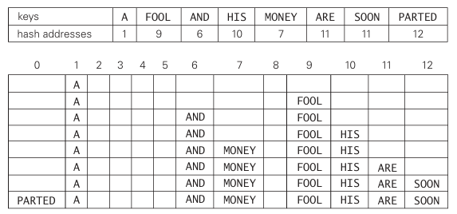
Closed Hashing

Slide 24
The Load Factor (α)
The ratio of the number of occupied slots n to the total table size m: α =n/m
Significance: It measures the performance health of the table.
Thresholds:
Open Addressing, α must be < 1.Performance degrades sharply as α to 1.
Rehashing: When α exceeds a threshold (typically 0.7 or 0.8), the table size is usually doubled to a new prime, and all keys are re-inserted.

Slide 25
Double Hashing
too avoid the clustering issues of linear probing, use a second hash function h2(K) to determine the "step size" for probes.
h(K, i) = (h1(K) + i . h2(K)) mod m
Rules for h2(K):
It must never return 0 (which would result in an infinite loop).
It should be relatively prime to the table size m to ensure all slots are reachable.

Slide 26
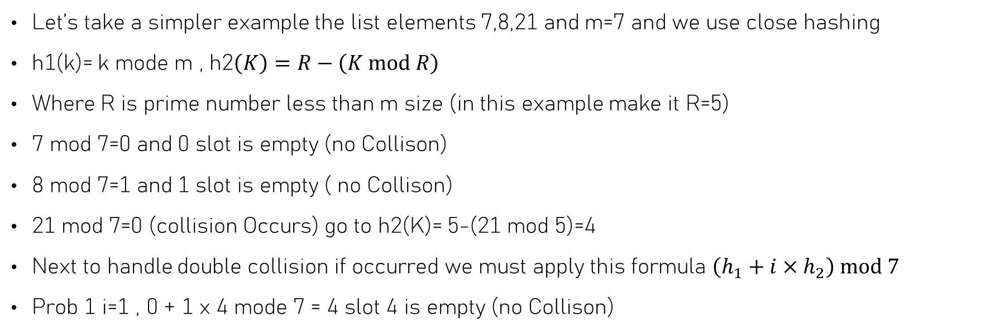
Double Hashing example
Let’s take a simpler example the list elements 7,8,21 and m=7 and we use close hashing
h1(k)= k mode m , h2$\left(K\right)=R−\left(K mod R\right)$
Where R is prime number less than m size (in this example make it R=5)
7 mod 7=0 and 0 slot is empty (no Collison)
8 mod 7=1 and 1 slot is empty ( no Collison)
21 mod 7=0 (collision Occurs) go to h2(K)= 5-(21 mod 5)=4
Next to handle double collision if occurred we must apply this formula $\left(h_{1}+i×h_{2}\right) mod 7$
Prob 1 i=1 , 0 + 1 x 4 mode 7 = 4 slot 4 is empty (no Collison)

